Slide 1
Department of Environmental Quality
Proposed Interbasin Transfer Certificate for the Kerr Lake Regional Water System
Water Allocation Committee November 4, 2015

Slide 2
Requested Certificate
Primary Applicant: Kerr Lake Regional Water System
Source Basin: | Roanoke
Receiving Basins: | Tar, Fishing Creek, Neuse
Grandfathered Transfer: 10 MGD | Requested Transfer: 14.2 MGD
Increased Transfer Amount: | 4.2 MGD
Total Requested IBT: 2045 Demands: | 14.2 MGD
Roanoke to Tar: | 10.7 MGD
Roanoke to Fishing Creek: | 1.7 MGD
Roanoke to Neuse: | 1.8 MGD
Department of Environmental Quality

Slide 3
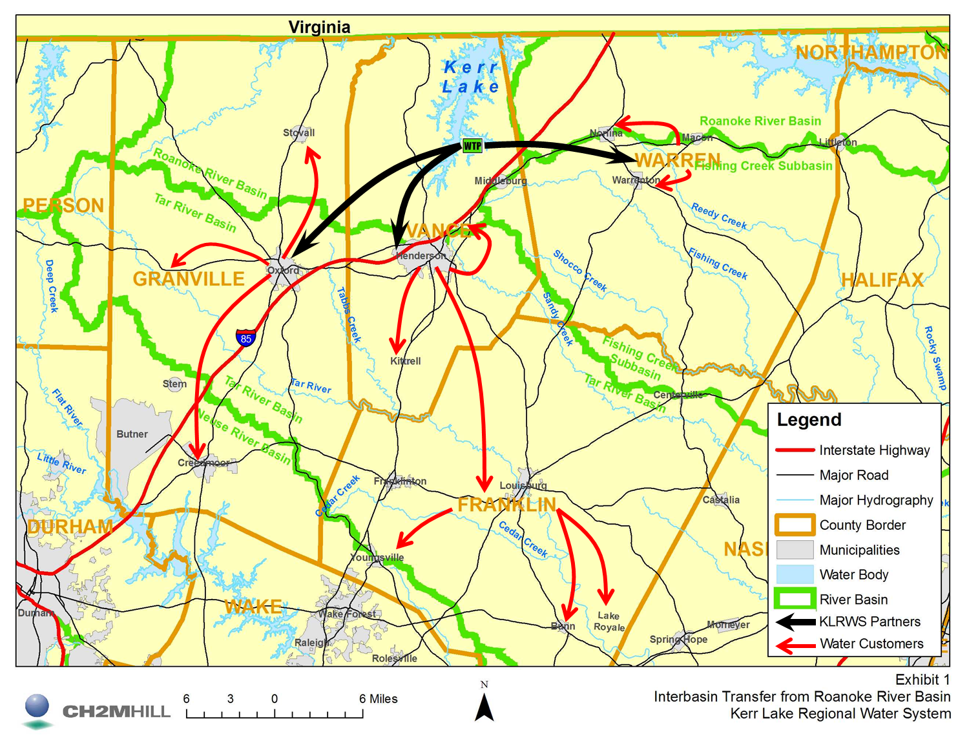
Kerr Lake Regional Water System (KLRWS)
Primary Partners
City of Henderson
City of Oxford
Warren County
City of Henderson operates WTP
Water sales to 11 additional communities/water users in Vance, Warren, Granville, and Franklin Counties
Department of Environmental Quality

Slide 4
Findings of Fact - §143-215.22L
The EMC shall specifically consider:
The necessity, reasonableness, and proposed uses of water transferred
Present and reasonably foreseeable detrimental effects on the source basin
Cumulative effects on the source major river basin of any water transfer or consumptive water use currently authorized or projected in a LWSP.
Present and reasonably foreseeable beneficial and detrimental effects on the receiving basin
The availability of reasonable alternatives to the proposed transfer
Use of impoundment storage capacity, if applicable
Purposes and water storage allocations in a US Army Corps of Engineers multipurpose reservoir
Whether the service area of the applicant is located in both the source and receiving basin
Any other facts or circumstances reasonably necessary
Department of Environmental Quality

Slide 5
1. Transfer Amount is Necessary and Reasonable for Proposed Uses
Within the planning period of 2045, the water demand will exceed the limits of the existing IBT
Groundwater resources in the area have insufficient quality and quantity to meet needs of individual homeowners
The Henderson WTP needs to be expanded soon
current demands are approaching 80% of plant capacity
other upgrades are needed
incorporate everything into the one expansion
KLRWS is not asking for their full 20 MGD Kerr Lake allocation from the USACE
Department of Environmental Quality

Slide 6
2. Insignificant Detrimental Effects on the Source River Basin
2045 IBT model scenario shows minimal impact
Kerr Lake elevation estimated to decrease by
2.4 inches with 2002 drought conditions and
1.2 inches with 2007 drought conditions
Reduction in flow out of Kerr Lake due to IBT:
0.07% on average
up to 0.3% under 2007 drought conditions
Local ordinances minimize secondary effects caused by growth in region serviced by KLRWS
Department of Environmental Quality

Slide 7
3. Insignificant Cumulative Effects on the Source Major River Basin
Modeling indicates that even during exceptional drought conditions, the proposed IBT increase will have negligible effects on the elevation of Kerr Lake
A comparison of reservoir releases under the baseline and IBT scenarios indicates that the proposed IBT would not require upstream releases to maintain the elevation of Kerr Lake and the lower reservoirs, even during periods of drought
Department of Environmental Quality

Slide 8
4. Insignificant Detrimental Effects on the Receiving Basins
Wastewater discharges within the limits of the current NPDES permitted flows
Stream flows are not expected to change significantly
Tar-Pamlico River basin & Falls Lake in the Neuse River basin have nutrient management strategies in place
Possible SCI from development and urbanization will be mitigated by implementation of existing federal, state, and local protection programs
Department of Environmental Quality

Slide 9
5. Reasonable Alternatives to the Proposed Transfer Considered
No action (Not to exceed grandfathered IBT of 10 mgd)
Increase IBT to meet 2045 needs (Proposed IBT Certificate)
Avoid IBT increase with alternative surface water:
Alternative 3a – surface water withdrawal from the Tar River Basin
Alternative 3b – construct a new reservoir on the Tar River
Alternative 3c – water withdrawal with offline storage in Tar River Basin
Avoid IBT increase by using groundwater sources
Minimize IBT by Returning to Roanoke River Basin
Use Coastal Water as a Source
Alternative 6a – Desalination technology
Alternative 6b – Pipe groundwater from PCS Phosphate Mine in Aurora
Department of Environmental Quality

Slide 10
6. Use of Impoundment Storage Capacity Not Applicable
KLRWS does not own, manage, or maintain a water supply impoundment.
Department of Environmental Quality

Slide 11
7. Consistent with Purposes of Corps of Engineers Multi-Purpose Reservoir
Kerr Lake includes a water supply pool that would be used in part for this IBT
57% of lake storage for flood control
41% for hydropower
2% for water supply
KLRWS began drawing water in 1978, received allocation of 20 MGD in 2005
Current IBT request of 14.2 MGD within KLRWS’s 20 MGD allocation from Kerr Lake
Negligible change to elevation of Kerr Lake from IBT, not expected to alter reservoir operations or recreation
Department of Environmental Quality

Slide 12
8. KLRWS’s Service Area is Located in Both the Source and Receiving River Basins
Percentage of KLRWS Service Area in Individual River Basins
System | River Basin
 | Roanoke | Tar | Neuse | Fishing Creek
Oxford |  | 100%
Granville Co. |  | 100%
Stovall | 100%
SGWASA |  |  | 100%
Wilton |  |  | 100%
Henderson | 30% | 70%
Franklin Co. |  | 85% | 15%
Bunn |  | 100%
Lake Royale |  | 100%
Vance Co. | 50% | 50%
Kittrell |  | 100%
Warren Co. | 38% |  |  | 62%
Warrenton |  |  |  | 100%
Norlina | 50% |  |  | 50%
Department of Environmental Quality

Slide 13
9. Any Other Facts or Circumstances that are Reasonably Necessary
Specific conditions in IBT certificate:
Submittal within 90 days of approval:
Water Conservation Plan
Drought Management Plan
Compliance and Monitoring Plan
Quarterly Monitoring Reports
Ability to reopen, amend, and modify, if necessary
No selling of transferred water to water systems that are not co-applicants on the Certificate
Department of Environmental Quality

Slide 14
Burden and Standard of Proof for the Final EMC Determination: § 143-215.22L(m)
The Commission shall grant a certificate for a water transfer if the Commission finds that the applicant has established by a preponderance of the evidence all of the following:
The benefits of the proposed transfer outweigh the detriments of the proposed transfer. In making this determination, the Commission shall be guided by the approved environmental document and the policy set out in subsection (t) of this section.
The detriments have been or will be mitigated to the maximum degree practicable.
The amount of the transfer does not exceed the amount of the projected shortfall under the applicant's water supply plan after first taking into account all other sources of water that are available to the applicant.
There are no reasonable alternatives to the proposed transfer.
Department of Environmental Quality

Slide 15
Action – Request WAC Support
Move the Interbasin Transfer Certificate allowing the Kerr Lake Regional Water System to increase their 10 MGD grandfathered IBT to 14.2 MGD to the full EMC at their November 5, 2015 meeting for a final determination.
Department of Environmental Quality

Slide 16
Questions?
Department of Environmental Quality

