Slide 1
Impediments and Challenges of Permitting Water Supply
Greenville Utilities Commission
Mary Sadler, PE
David Springer, PE

Slide 2
Why is this discussion important?
GUC’s water supply issues are not unique in North Carolina
A timeframe of decades for securing new water supply is unacceptable for protecting public health and safety
What are we disputing?
Regulatory process is flawed
Policy and/or rules change frequently
Lack of decision-making authority
What are action items?
Support recent NC AWWA-WEA and NCLM recommendations
Find a conclusion to GUC’s water supply planning effort

Slide 3
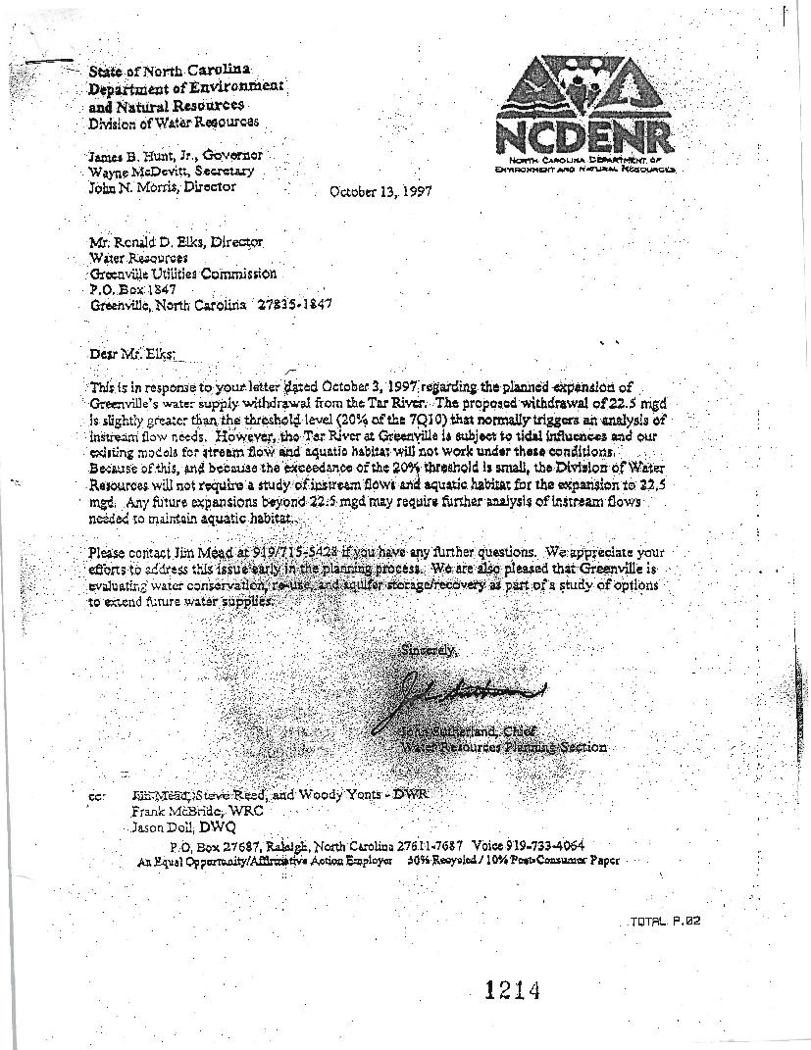
DWR staff stated in 1997 that existing models not applicable to GUC’s intake
Tidally influenced
GUC knew in 1997 that a large (and expensive) flow study would be required for the next WTP expansion

Slide 4
Timeline for GUC’s water supply resources journey:
2006
2007
2008
2009
2010
2011
2012
2013
2014
2015
We started at “GO”
We can’t seem to get past “GO”

Slide 5
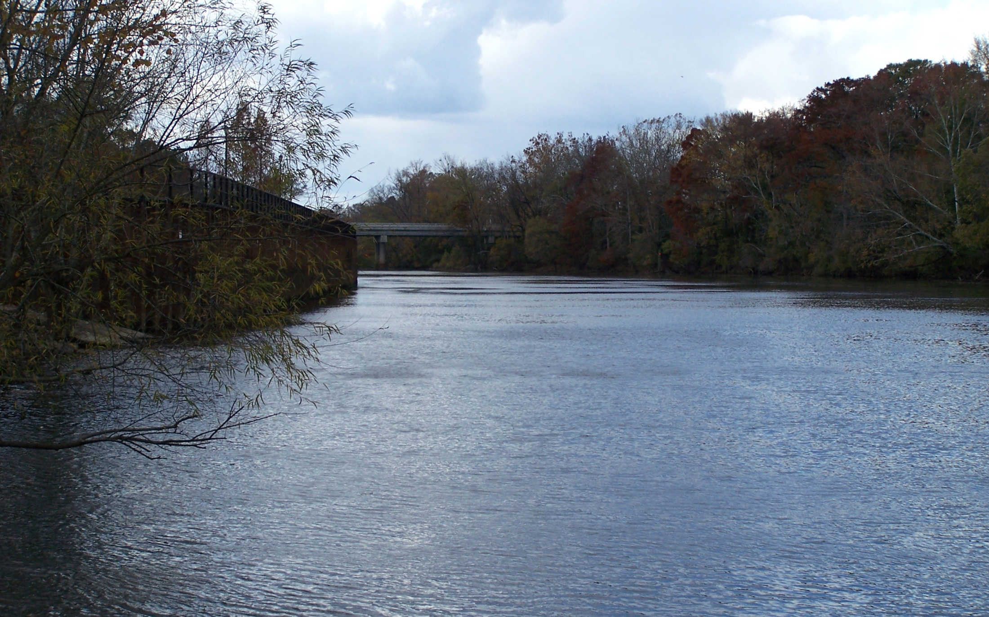
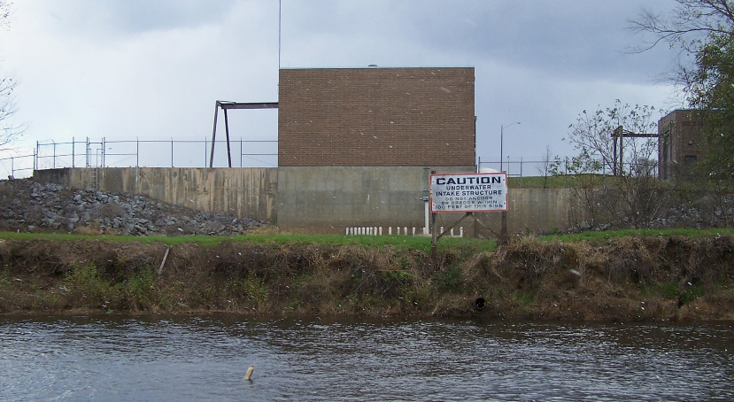
GUC withdrawing from the Tar since 1905
Last WTP Expansion to 22.5 mgd completed in 2002

Slide 6
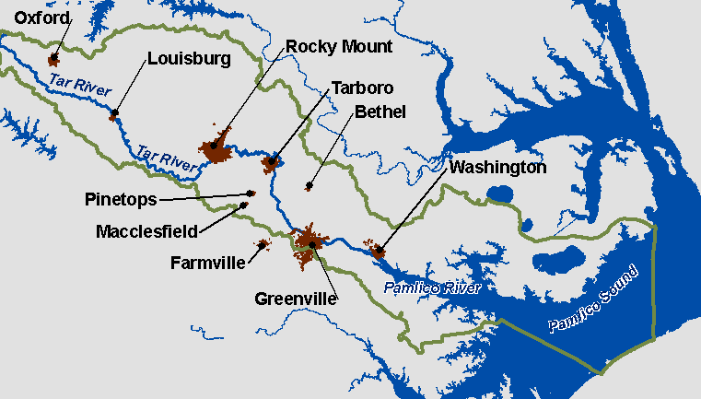

Slide 7
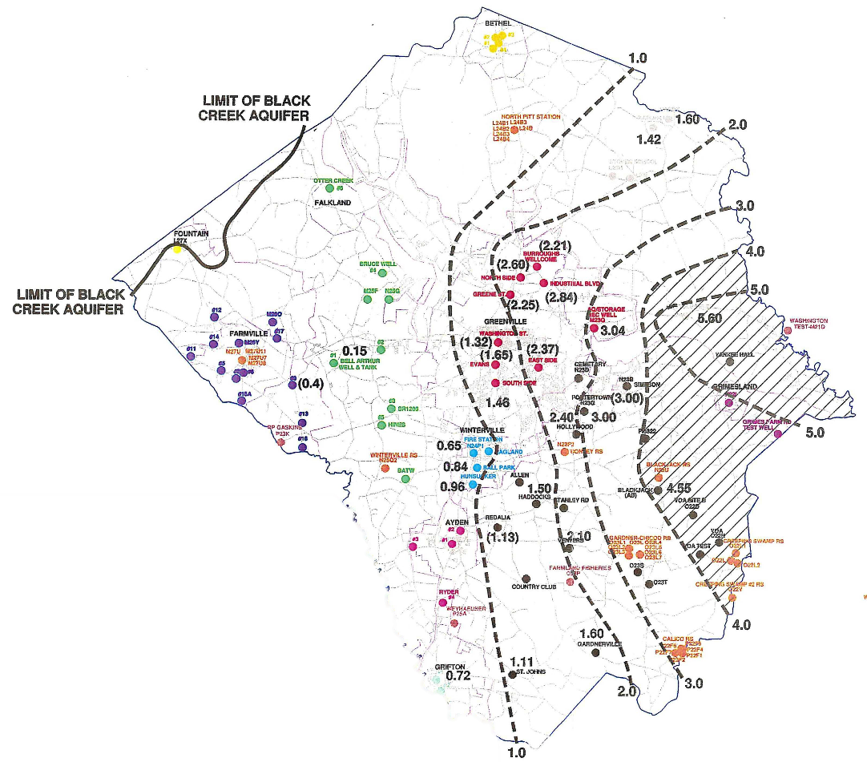
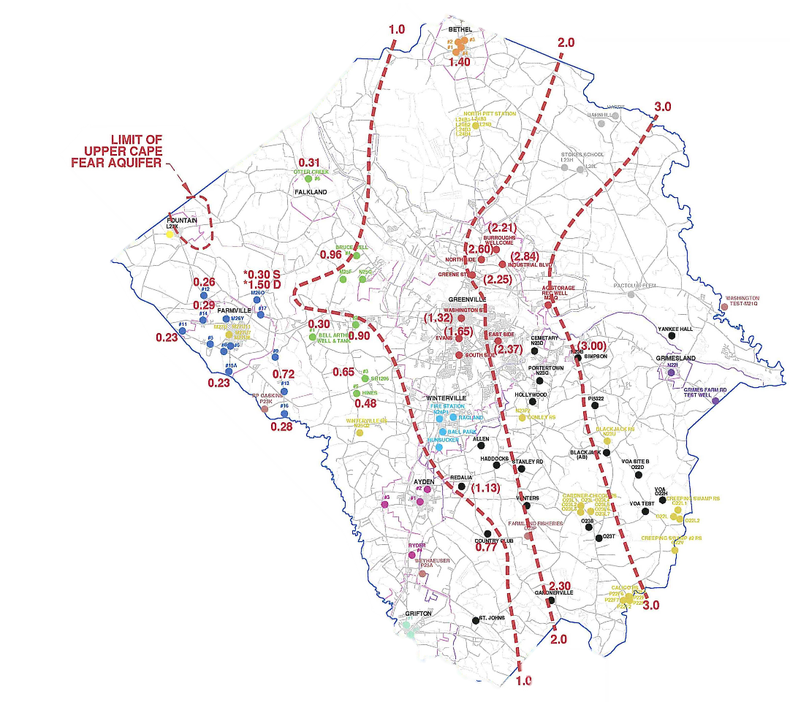
Groundwater supply yields little capacity (< 1 mgd)
GUC’s wells (Black Creek & Lower Cape Fear) have fluoride water quality issues
MCL 4 ppm, SMCL 2 ppm

Slide 8
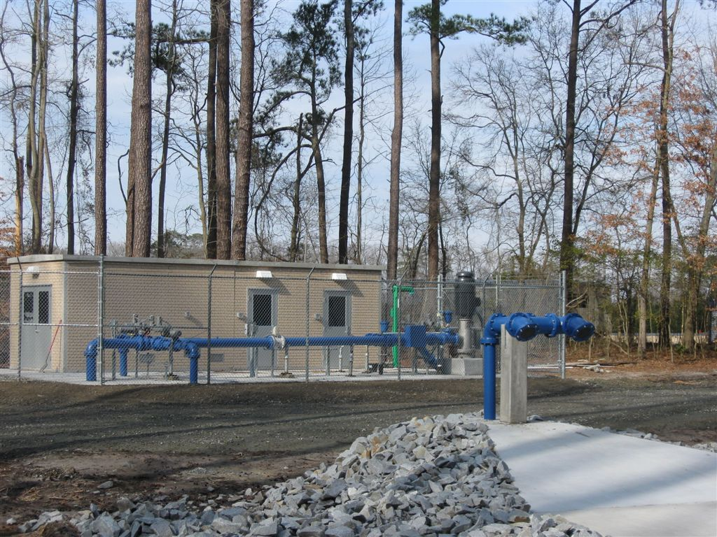
Aquifer Storage and Recovery (ASR) Wells
Well designed to peak shave maximum day water demand
Peak shaving capacity of 1.4 mgd
ASR well undergoing required state testing
Water quality issues, so long-term viability uncertain

Slide 9
2006
2007
2008
2009
2010
2011
2012
2013
2014
2015
IBT effort started
FONSI received
IBT Certificate November 2010
IBT process started in 2006
A WTP expansion was not part of IBT, so Tar River Flow study was not required
Other hydrologic modeling method was required to support IBT
FONSI in 2008
During Finding of Fact Phase, EMC asked for an EIS‐like analysis of alternatives even with FONSI
GUC spent $330k

Slide 10
2006
2007
2008
2009
2010
2011
2012
2013
2014
2015
IBT effort started
FONSI received
IBT Certificate November 2010
Unreasonable conditions attached to IBT Certificate
Greene County had to implement Phase II post construction measures
In 2010 Greene County was ranked 82/100 in population, 86/100 in income
Impervious surface analysis of ENTIRE County normalized to anticipated population growth indicated less than a 0.47% increase in impervious surface
IBT process did not fairly weigh positive benefit of protecting groundwater resource

Slide 11
2006
2007
2008
2009
2010
2011
2012
2013
2014
2015
Scoping effort started for Tar River Flow Study
1997 letter from DENR
Letter stated Flow Study MAY be needed for next WTP expansion
Withdrawals > 20% of 7Q10 considered an impact per 15A NCAC 01C .0408(2)(b) and 15A NCAC 2K .0100
GUC interpreted the “MAY BE” required as a “WILL BE” required

Slide 12
2006
2007
2008
2009
2010
2011
2012
2013
2014
2015
Start of Flow Study
Scoping effort started for Tar River Flow Study
Flow study started well before WTP expansion would be needed
Anticipated >>>> Time and >>>> $$$$
GUC spent $1.3 million
Based on scoping, decision made to assemble a Technical Advisory Group (TAG)
Notes:
GUC planned well in advance

Slide 13
Technical Advisory Group: 11 State and Federal Agency Members

Slide 14
Scoping process provided valuable information
General agency awareness of:
CCPCUA and pressure on surface water supplies
Greenville Utilities ASR progress
Flow-related water quality / habitat issues in Tar River and Pamlico Sound
Limited agency experience:
Analysis in tidal environments
Only key regulatory staff knowledgeable
Few suggestions on specific approaches
No mention of how to address sensitive aquatic species
Tar River at Greenville designated as Inland Primary Nursery Habitat
DWR considered water quality in the Tar River to be good
Segments of Pamlico Sound considered impaired due to high chlorophyll-a and low dissolved oxygen levels

Slide 15
Lower Tar Pamlico River EFDC and water quality model:
Basin Hydrology, Historic Flow, Consumptive Uses
Stage, Temperature, Salinity, and Other Water Quality Parameters
Hydrographic Survey of Depth, Bottom Type, and Structure
Basin Hydrologic Model
Hydrodynamic Model (Lower Tar Pamlico River – LTPR)
Bathymetric, Habitat, and Grid Model
Habitat Mapping, Study Site Selection, Additional Site Data
Existing and Future Tar River Flow
Water Quality Data and Hydrology for Calibration
Predicted Stage, Depth, Velocity, Tidal Circulation
Water Quality Model
Habitat Model
Simulation of flow, habitat, and water quality conditions for various scenarios to evaluate potential effects from total and consumptive water withdrawals
Notes:
Complicated model
Lots of time and money
>>>> changes to Flow Study per recommendation of TAG, >>> $$$ of project

Slide 16
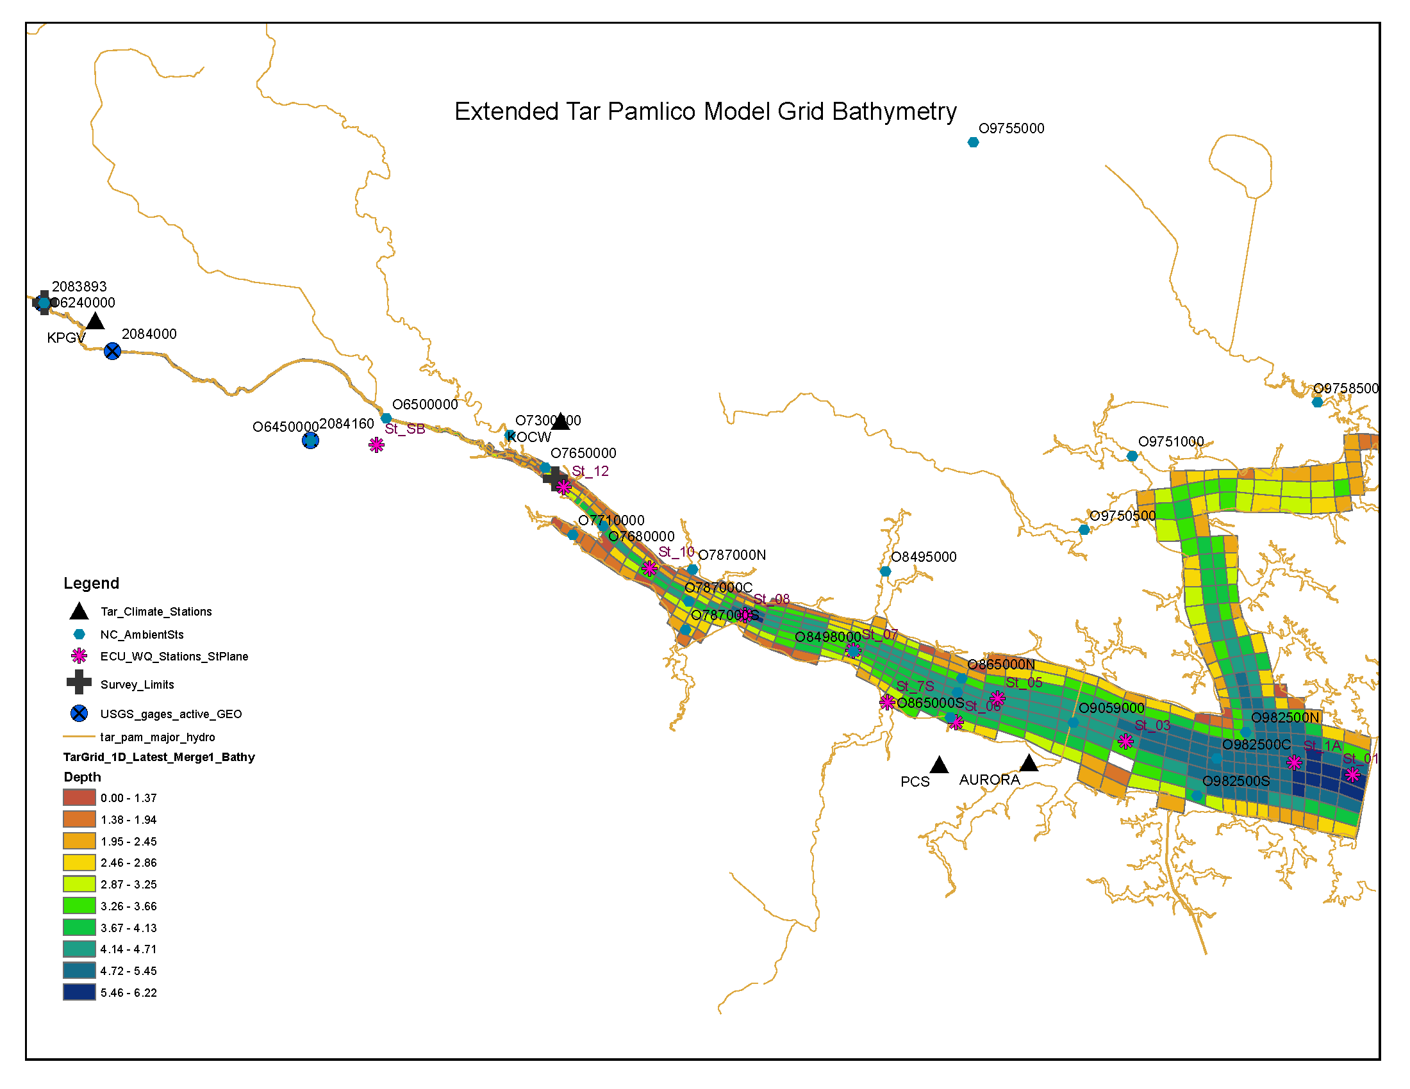
EFDC is NOT a steady state model (Oasis)
>>> Time and money spent on TAG comments and concurrence
TAG expanded scope of original study plan

Slide 17
EFDC modeled a managed system demand for a year 2050 planning period
Uncertain of the specific WTP expansion increment
Effort considered IBT partners (consumptive use), WWTP flow projections, and updated GUC water demand projections
EFDC Model Scenario | Average Daily Withdrawal (mgd) | Maximum Day Withdrawal (mgd) | WTP Return (mgd) | WWTP Discharge (mgd) | Consumptive Use (mgd)
Existing | 13.3 | 17.7 | 0.5 | 10.2 | 2.6
2050 | 47.1 | 60.7 | 1.9 | 30.4 | 14.7

Slide 18
2006
2007
2008
2009
2010
2011
2012
2013
2014
2015
GUC MOA Request
Final Flow Study published
Start of Flow Study
Scoping effort started for Tar River Flow Study
GUC approached DWR in 2012 about a Memorandum of Agreement documenting results of Flow Study
Answer:
Notes:
GUC planned well in advance

Slide 19
2006
2007
2008
2009
2010
2011
2012
2013
2014
2015
Start of Tar Pamlico Model Effort for Basin Stakeholders
GUC sends letter to DWR
DWR requests use of Tar River EFDC model to complete basin planning
GUC spends money to train DWR staff on use of EFDC model
Public Notice for OASIS and EFDC models
HB 1743 process stopped
HB 1743 kicks off for Tar Pamlico stakeholders in 2010
DENR-approved steady state OASIS model used
GUC sends letter to DWR:
“OASIS model not applicable at GUC intake”
Notes:
Point out that everyone else in the basin had their model paid for.

Slide 20
2006
2007
2008
2009
2010
2011
2012
2013
2014
2015
Start of Tar Pamlico Model Effort for Basin Stakeholders
GUC sends letter to DWR
DWR requests use of Tar River EFDC model to complete basin planning
GUC spends money to train DWR staff on use of EFDC model
Public Notice for OASIS and EFDC models
HB 1743 process stopped
One year later (2012)…DWR acknowledges that OASIS not applicable to GUC’s tidally influenced intake
Fact known in 1997
DWR a TAG member of Tar River Flow Study since 2008
GUC never reimbursed for EFDC model effort
Only utility in NC that had to pay for their own model
Notes:
Point out that everyone else in the basin had their model paid for.

Slide 21
2006
2007
2008
2009
2010
2011
2012
2013
2014
2015
DWR only approved the EFDC portion of model as part of HB 1743
TAG-requested water quality model was NOT included
Basinwide model approval halted as a result of Ecological Flow Study in 2013 and peer review issues in 2015
Lost opportunity for leveraging model approval
GUC supported suspending basin-wide model approvals for greater good

Slide 22
2006
2007
2008
2009
2010
2011
2012
2013
2014
2015
HB 609 was answer to GUC’s request for an MOA
In May 2012, met with DENR Secretary and DWR
Lots of questions:
General process
Agency primacy (decision-making authority)
Preferred alternative selection
IBT considerations
How will process conclusions be documented?
How will EFDC model approval be achieved?
Few answers
GUC passed resolution in July 2012 to enter into HB 609 process
Fall 2012 meetings with DWR:
Water demand projections and water conservation analysis
Water supply alternatives from Master Plan
Tar River Flow Study presentation
Notes:
HB 609 questions:
General process
Agency primacy (decision-making authority)
Preferred alternatives selection
IBT considerations
How will process conclusions be documented?
How will EFDC model approval be achieved?

Slide 23
2006
2007
2008
2009
2010
2011
2012
2013
2014
2015
GUC spent an additional $70k on HB 609 and HB 1743 efforts
DWR met with agency representatives in Fall 2014 to discuss EFDC model for HB 609
DWR Email and Final Memorandum in January 2015

Slide 24
Group required DMF concurrence
NEW
NEW
NEW
NEW
GUC did not have a seat at the table
NEW
Notes:
GUC or consultants not asked to weigh in.
Many folks around table discussing issue were not members of the original TAG (retirements, moved on to different positions, etc.)

Slide 25
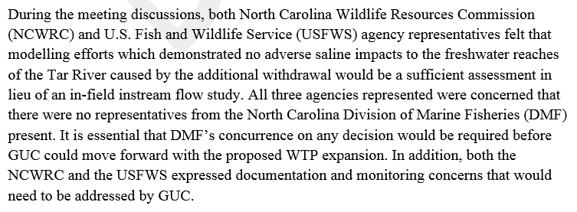
HB 609 email and Memo from DENR on January 19, 2015:
email:
memorandum:
In-field instream flow study issue resolved in 2009!!
Additional documentation??

Slide 26
2006
2007
2008
2009
2010
2011
2012
2013
2014
2015
Here we are in 2015
10. Long. Years. Later.
GUC knew the answer to the water supply question in 2007
GUC followed all the rules, planned ahead, asked agency representatives for input
GUC has spent $1.7 million to date

Slide 27
2006
2007
2008
2009
2010
2011
2012
2013
2014
2015
No clear conclusion from HB 609
GUC’s water supply future is still uncertain
Is massive / expensive Tar River Flow Study going to be applicable in 10 to 15 years?
Flow Study demonstrated NO IMPACT at a 2050 maximum day withdrawal

Slide 28
2006
2007
2008
2009
2010
2011
2012
2013
2014
2015
HB 795 effectively eliminates SEPA for most projects
Unclear if the WTP expansion project will trigger new legislative SEPA criteria
Possible federal funding
Is GUC going to have to keep defending this work every 5 to 8 years?
How can GUC preserve the conclusions of the Tar River Flow Study?

Slide 29
Greenville Utilities lends support to NC AWWA-WEA and NC League of Municipalities proposal
Proposal recommendations:
Regulated riparianism / permitted water withdrawal
Capacity Use Area designations for surface water
Encourage regional water supply planning
Ecological flow should not be a stand-alone regulatory component without water supply considerations
Review interbasin transfer regulation
Increased cooperation with state agencies
Decision-making authority
Regulatory support
Accountability

Slide 30
Questions?
springdw@guc.com
msadler@hazenandsawyer.com

