Slide 1
Setting the Stage:
Reservoirs for Water Supply in North Carolina
Water Allocation Committee
Environmental Management Commission
May 8, 2019

Slide 2
Lakes and Reservoirs in North Carolina
Total freshwater ponds, lakes or reservoirs > 10 acres = 1,428
Lakes and reservoirs with designated use rating = 175 (12% of total)
Lakes and reservoirs identified as regular or emergency water source = 103 (7% of total)
Water systems that identify lakes and reservoirs as water source = 83

Slide 3
Water Supply Reservoirs in North Carolina
Type | # Reservoirs | # Water Systems | Current Pop Served | 2050 Projected Pop Served
Hydropower | 17 (17%) | 29 (33%) | 2,947,000 (49%) | 4,877,000 (50%)
Municipal | 86 (83%) | 58 (67%) | 3,066,000 (51%) | 4,850,000 (50%)
Total | 103 | 87 | 6,013,000 | 9,727,000
Department of Environmental Quality

Slide 4
Hydropower Reservoirs in North Carolina
Owner (Total # Hydropower Reservoirs in NC) | # Reservoirs for Water Supply | # Water Systems Served by Reservoirs | Population Served | 2050 Projected Population
Cube Hydro (4) | 2 | 2 | 18,000 | 19,400
Dominion Energy (2) | 1 | 1 | 16,000 | 15,000
Duke Energy (24) | 8 | 15 | 1,350,000 | 2,183,000
TVA (4) | 2 | 2 | 150 | 280
USACE (4) | 4 | 9 | 1,563,000 | 2,660,000
Others (2) | -- | -- | -- | --
Total (40) | 17 | 29 | 2,947,000 | 4,877,000
Department of Environmental Quality

Slide 6
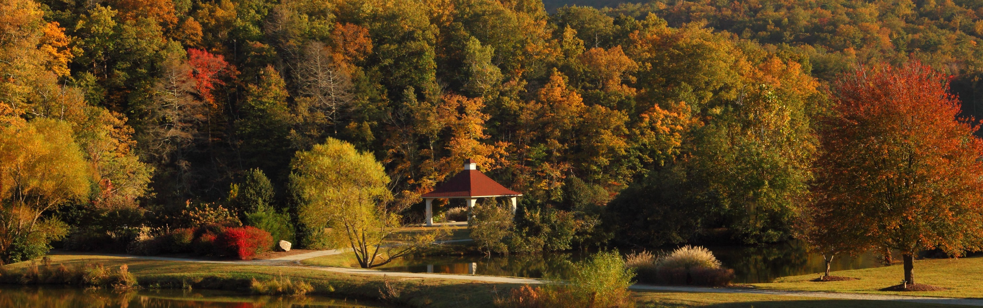
Questions?
Department of Environmental Quality

